Slide 1
Government- the basics
Tabitha Bathras

Slide 2
Maryland State Curriculum
Political Science
  Describe responsibilities associated with the 5 basic rights and explain why these responsibilities are important
  Identify various sources of information that are available to citizens to make political decisions
  Describe the rule of law and explain how it impacts individuals and groups
  Outline the structure and function of the MD General Assembly and the roles of state senators and delegates
  Describe the role of MD’s state judiciary system
Social Studies Skills & Processes
  Engage in civic participation and public discourse
4th grade
2 week duration

Slide 3
Brain Target One
Emotional Climate
  Opening day activity
  What “rights” do you have?
    Students create a circle map to show “rights” they think they have
    Watch PowerPoint of the 5 Basic Rights
    Group tableau to represent one of the 5 basic rights
Seagull Feather Tickets- behavior reward system
Govt. Branch Presentation Day- Dress for Success!

Slide 4
Brain Target Two
Physical Environment
Desks are grouped for student collaboration
Open space areas are available for tableau presentation
Significant govt. buildings displayed
  White House- executive branch
  Capitol Building- legislative branch
  Supreme Court building- judicial branch
“Roles” of Government bulletin board
  Paper towel rolls are used to hang the “roles” for each branch-creates novelty

Slide 5
Brain Target Three
Designing the Learning Experience
Day 2 Activity
  Groups given a skeleton tree map and must organize vocabulary words related to the branches of the federal govt. to show background knowledge
  After formative assessment of prior knowledge students will go into the text to “fix” the tree map
  Organization of MD state govt. tree map will be displayed and students will compare/contrast
  Wrap up- Frame of Reference ties together basic rights lesson and structure of govt., as well as providing “big questions”

Slide 6
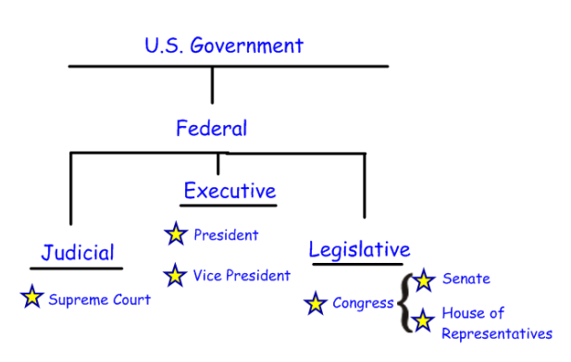
Brain Target Three
Designing the Learning Experience

Slide 7
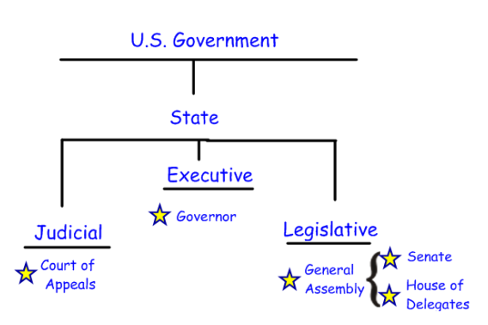
Brain Target Three
Designing the Learning Experience

Slide 8
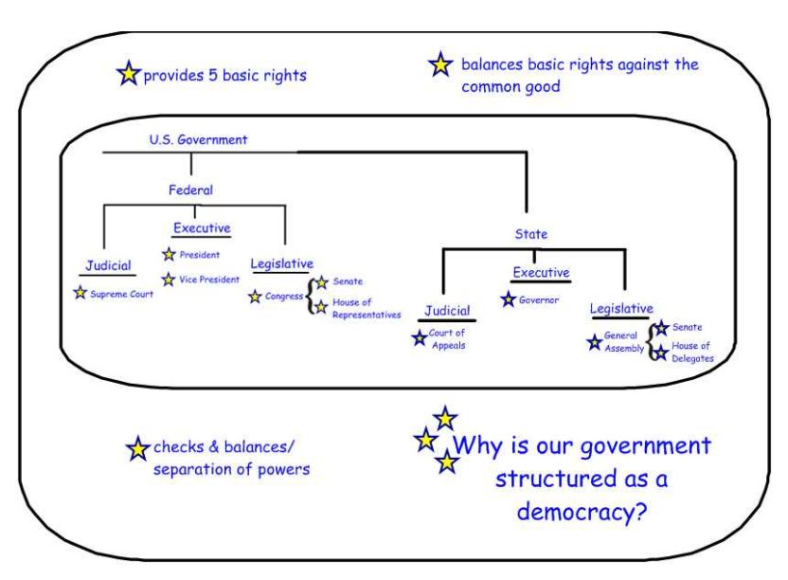
Brain Target Three
Designing the Learning Experience

Slide 9
Brain Target Four
Declarative & Procedural Knowledge
Day 3 Activity: Executive Branch
  PowerPoint on the federal executive branch
  Presidential Powers! partner activity
    Students decide which of 4 presidential powers the President would use in 8 different scenarios
  Tree Map review of comparison between federal and state executive branches
  Wrap Up- Bucket of Stuff
    Each group is given a bucket of random items and must represent the role of the federal executive branch by creating a display and explaining their thinking

Slide 10
Brain Target Four
Declarative & Procedural Knowledge
Day 4 Activity: Legislative Branch
  PowerPoint on the federal legislative branch
    Vocabulary- veto & 3/5 majority
  School House Rock video- “I’m just a bill”
    http://www.youtube.com/watch?v=_TI8xqLl_-w
  Model “The Teacher Bill”
    Demonstrate identifying pros/cons while considering people the bill will effect
    Vote based on the pros/cons
  Group Bills
    Students will identify pros/cons in groups and then present their bill to the class
    Class vote for each bill
  Tree Map review of comparison between federal and state legislative branches

Slide 11
Brain Target Four
Declarative & Procedural Knowledge
Day 5 Activity: Judicial Branch
  PowerPoint on the federal judicial branch
  Model the “Johnson Elementary Case”
    Students discuss case in pairs and then with whole group
    Model how to write an opinion while thinking aloud about how to consider the “spirit” of the law when making a decision
  Group Cases
    Students divided into 3 large groups and given talking chips to promote and level the discussion
    Write a group opinion on the case and then present their opinion to the class
  Tree Map review of comparison between federal and state judicial branches

Slide 12
Brain Target Five
Extension & Application of Knowledge
Week 2 Activity
  Create a Branch of Government!
    Groups of 4-5 students
    Choice of poster/PowerPoint/Smartboard
    Define the purpose of the branch
    Explain why the branch is necessary by creating a fictitious scenario
    Define their “positions” within the branch
    Create a building to represent their branch
  Presentation Day- Dress for Success!

Slide 13
Brain Target Six
Evaluating Learning
Executive Branch
  Formative assessment through Bucket of Stuff-explain your thinking
Legislative Branch
  Formative assessment through observation of groups and discussion of pros/cons of bills
Judicial Branch
  Formative Assessment through group presentation of problem and verdict with supporting details

Slide 14
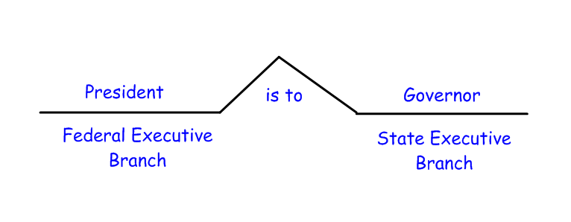
Brain Target Six
Evaluating Learning
Summative Assessments
  Brace Map Analogies
    Students given federal-level descriptors and must create an analogy with the matching state descriptor (Word Banks given to students with accommodations)

Slide 15
Brain Target Six
Evaluating Learning
Summative Assessments
  Create a Branch of Government!
    Rubric provided for presentation
    During presentations audience members will record on an index card one thing the group did very well and one thing they could have improved on
    Groups will be given an opportunity to review the reflection cards
  Write a reflection paragraph based on the “big question” from BT-3…
        Why is our government structured as a democracy?

